Slide 1
Lightweight Privacy-Preserving Collaborative Learning for IoT Objects
Linshan Jiang¹ Rui Tan¹ Xin Lou² Guosheng Lin¹
¹Nanyang Technological University
²Illinois at Singapore
Notes:
Good afternoon, I am Linshan Jiang from NTU of Singapore. Today I am going to present my work of …
In this work, I work with Rui, Xin, and Guosheng.

Slide 2
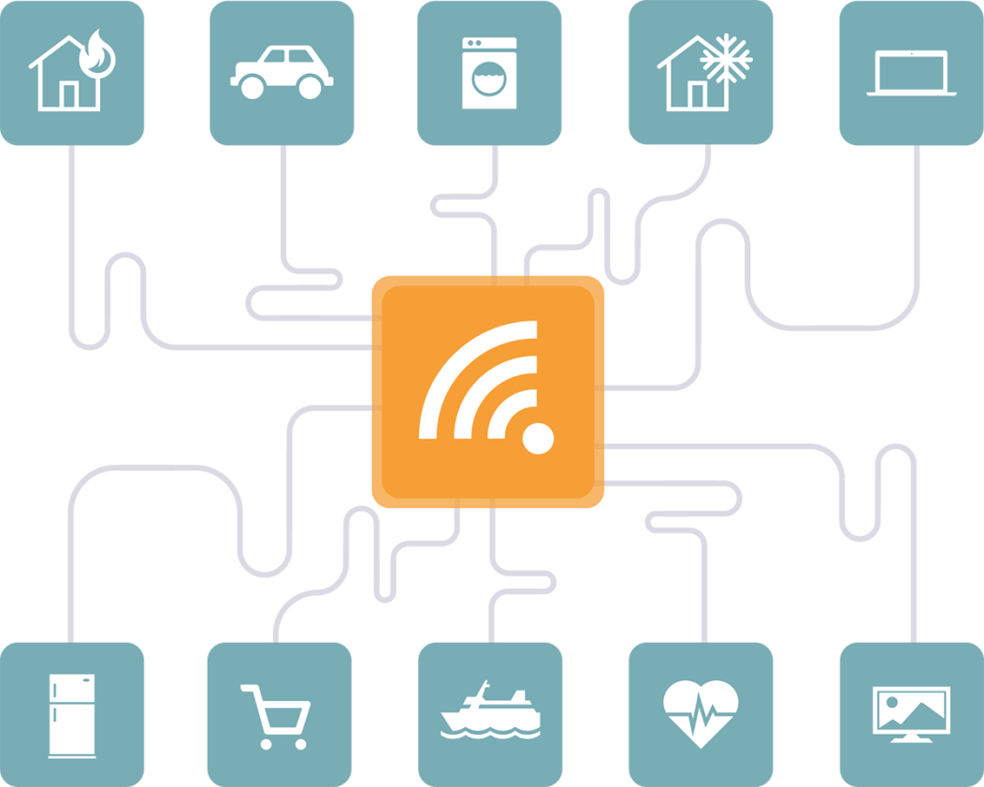
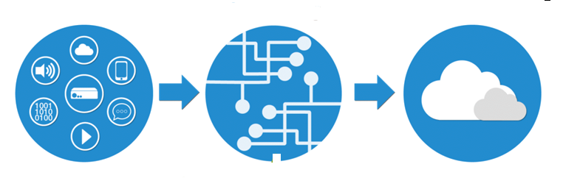
Internet of Things
IoT End device
Fog/edge
Cloud
Data generation infrastructure
30 billion connected devices
5 quintillion bytes every day
Computing infrastructure
Three layers of computing capabilities
Notes:
IoT will be a main data generation infrastructure with more than 30 billion connected devices. It will generate 5 quintillion bytes of data everyday.
IoT will be also the largest computing infrastructure consisting of three layers from the end devices, edges or fogs, to the cloud.
An important research problem is how to extract knowledge from the massive IoT data with the three layers of computing capabilities.

Slide 3
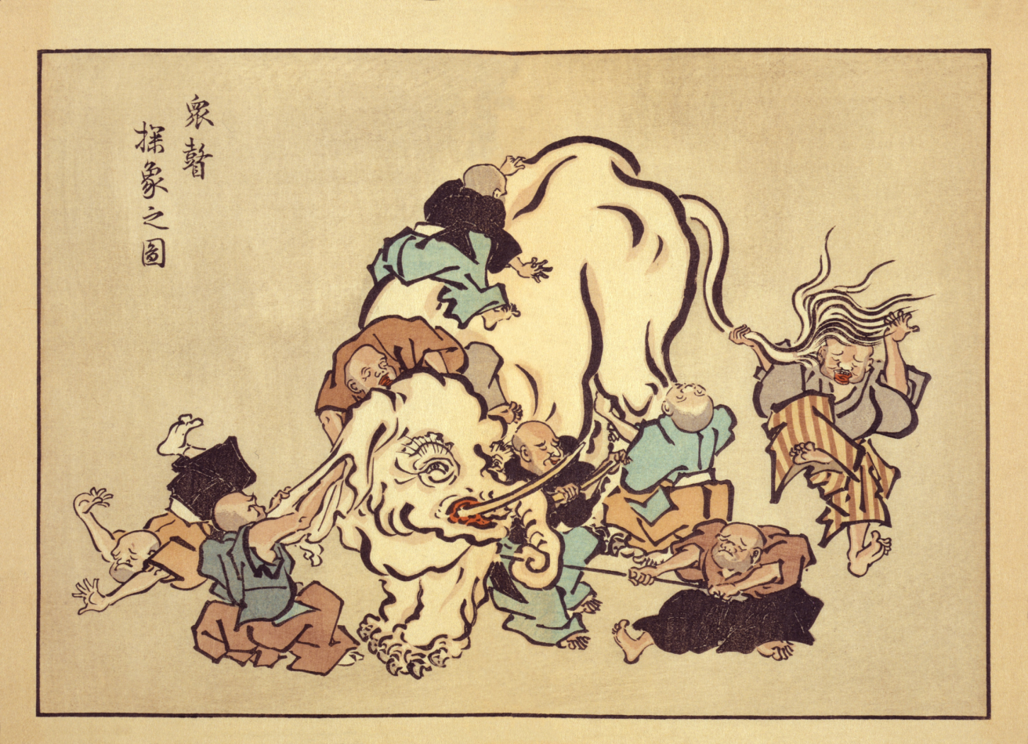
Locality Impedes Learning
Each IoT object observes a small portion of the process
IoT object
IoT object
Blind Monks Appraising an Elephant
Notes:
However, the IoT sensing devices are spatially distributed and deeply embedded into the physical processes. Thus, they can only observe a small portion of the process. As a result, their own individual knowledgebase is limited.

Slide 4
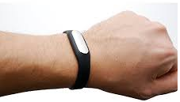



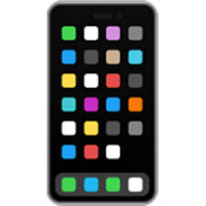



Collaboration Helps
Learn a flower recognition model
Alice
Heartbeat and three-axis acceleration data
Bob
Flower data
Flower data
Flower data
Learn a stress model
Eve
Violet
African Daisy
Hibiscus
Flower recognition
Stress detection
Notes:
To address this issue, collaboration among the IoT devices will be useful.
For example, if we want to construct a model that can recognize the type of flower, then we can develop a mobile app and let a large number of people to contribute labeled flower images. So, the constructed model can cover a wide spectrum of flowers.
For another example, If we want to build a model to detect stress based on wearable sensing data, we can ask many volunteers to contribute sensing data and their stress labels, so that we can build a better model.

Slide 5
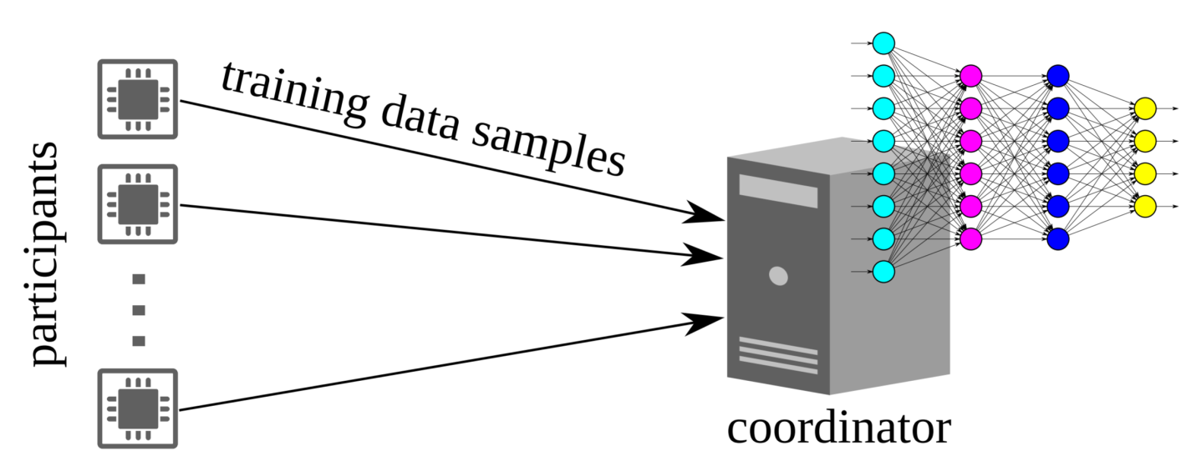
Collaborative Learning in IoT
Collaborative learning
Each participant contributes training data and enjoy improved machine intelligence in return
A powerful coordinator executes advanced, compute-intensive learning algorithms for intelligence of a crowd
But, concern of privacy leak
Notes:
In this work, we consider this collaborative learning architecture for IoT. In this architecture, we have a large number of participants, and a learning coordinator. Each participant contributes training data and enjoy improved machine intelligence in return. A powerful coordinator executes advanced, compute-intensive learning algorithms for intelligence of a crowd.
However, the training data samples may contain privacy sensitive information. For example, in stress detection application, the wearable sensing data may contain privacy-sensitive information.
So, this collaborative learning architecture may bring the concern of privacy leak.

Slide 6
Privacy-Preserving Collaborative Learning
Distributed machine learning
Crowd-ML: collaborative shallow learning [ICDCS’15]
Collaborative deep learning [CCS’15] and homomorphic encryption enhancement [TIFS’18]
Federated learning [Google, arXiv’16] and secure aggregation enhancement [CCS’17]
Drawbacks
Local training is infeasible for resource-constrained IoT objects
High communication overhead in learning iterations
Notes:
Privacy-preserving collaborative learning has received research recently. The existing studies can be classified into several categories.
The first category is distributed machine learning. The key idea of distributed machine learning is, the participants will train their local models and then exchange and update their models. After an iterative process, their models will converge and capture the data at all participants. But in this process, the training data are not exchanged.
Examples of the distributed machine learning include the recently proposed crown-ML, collaborative deep learning, and the more recent federated learning.
However, the drawback of the distributed learning approach is: the local training is infeasible for resource-contrained IoT objects. And it also incurs high communication overhead in the learning iterations.

Slide 7
Privacy-Preserving Collaborative Learning
Training data encryption/obfuscation
Homomorphic encryption on training and testing data [Microsoft , ICISC’12] Enterprise setting: Too compute-intensive for IoT objects
Random Gaussian projection [TKDE’06, Computer Networks’18] Only consider a single participant
Random Gaussian projection [SenSys’12] Only applicable to distance-based shallow learning, a clear privacy vulnerability
Notes:
The second category is training data encryption and obfuscation. The key idea is to encrypt or obfuscate the training data before feeding into the learning algorithms.
Homomorphic encryption has been applied for this purpose because the encrypted data can be still used to compute the polynomial of the original data. However, hormophic encryption is too compute-intensive for IoT objects.
Random Gaussian projection has been used to obfuscate training data. Originally, this approach can only support a single participant. Recently, in a sensys paper,this approach is extended to address multiple participants. However, this appooach is only applicable to distance-based shallow learning. And there is a clear privacy vulnerability, that we will detail shortly.

Slide 8
Other Related Work
Privacy-preserving inference outsourcing [Microsoft, ICML’16]
Training: plaintext
Inference: homomorphically encrypted
Differentially private machine learning [Google, CCS’16]
Training: plaintext
Training data is protected after releasing trained model
Fully trusted
learning
coordinator
Curious learning coordinator in our work
Notes:
There are also other related works.
In the privacy-preserving inference outsourcing, the model is trained using plaintext. During the inference phase, the testing sample is encrypted. So that the inference computation can be outsourced without hurting privacy.
In the differentially private machine learning, the training is also based on plaintext. But the training process will be added with random noises, such that if the model is released, the differential privacy of the training data is preserved.
In these two models, the training process is trusted. Differently, in our work, the training process is not fully trusted.

Slide 9

Problem Statement
Privacy model
Protect confidentiality of the raw forms of the training data against the honest-but-curious coordinator
Participants don’t expect label privacy
Possible collusion between participants and coordinator
Notes:
Now, I will present our privacy model. We aim to protect the confidentiality of the raw forms of the training data against the honest-but-curious coordinator.
By “Honest”, we mean that the cooridinator will not mislead the par, and it will not corrupt any data.
By “Curious”, we mean that the cooridinator wants to know the raw form data, such that it can use the data for other applications that are not authorized by the participants.
In our privacy model, we assume that the partcipants don’t expect label privacy. So the labels can be transmitted to the coordinator.
We also aim to address the possible collusion between the participants and the coordinator. Say, if some participants collude with the coordinator, the privacy of other participants will not be compromised.

Slide 10
Approach
x
=
Participant
During system initialization, participant i independently generates a random Gaussian matrix R_{i}
Send the projected data R_{i}x and the label to coordinator
Implementable on tiny processors and low complexity
Coordinator
Apply deep learning on projected data from all participants
x
=
Coordinator
R
x
Rx
Notes:
To achieve our privacy model, our approach is designed as follows. During system initialization, each participant i independently generates a random Gaussian matrix and then Send the projected data R_{i}x and the label to coordinator. It is Implementable on tiny processors and has low complexity. The Coordinator will apply deep learning on projected data from all participants.

Slide 11
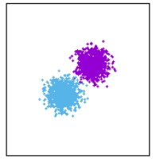
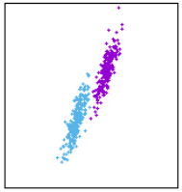
Random Gaussian Projection
Distance preservation
Implementation of Johnson-Lindenstrauss lemma
Learnable in feature extraction
If R is unknown, it is computationally difficult (practically impossible) to reconstruct a meaningful x from y
R unknown to coordinator, ensures privacy
Different Rs for participants preclude collusion between participant and coordinator
Original data
Projected data
Notes:
We discuss about Random gaussian projection first. Random Gaussian Projection is a Distance preservation method, It is an Implementation of Johnson-Lindenstrauss lemma. Because of Distance preservation, it is Learnable in feature extraction for distance-based classifier. Random Gaussian Projection has a property:If R is unknown, it is computationally difficult (practically impossible) to reconstruct a meaningful x from y. Thus R unknown to coordinator, it ensures privacy. Meanwhile, if we apply Different Rs for participants, it can preclude collusion btw participant and coordinator. However, applying Different Rs brings new challenges.

Slide 12
The SenSys’12 Paper*
Different Rs to preclude collusion
Distance is not preserved
Coordinator asks participants to project public data vectors to learn a pair-wise regress function
Known plaintext attack: well crafted public data vectors will reveal the projection matrix!
*Cloud-enabled privacy-preserving collaborative learning for mobile sensing, sensys 12
Notes:
Distance between two samples is not preserved after applying Different Rs. To address this issue, the SenSys’12 Paper proposes a method that the Coordinator asks participants to project public data vectors and return the results to learn a pair-wise regress function
With the regress function, we can regain the distance preservation property. However, this approach can be easily affected by the Known plaintext attack, in which well crafted public data vectors will reveal the projection matrix!

Slide 13
Example
1
0
Projected public
data vector
returned
to coordinator
x
=
0
0
0
Random matrix R
Public data vector
Notes:
For example, if the public data vector contains only one non-zero element, the corresponding column of the random matrix is revealed.

Slide 14
Unsupervised Feature Learning
How unsupervised feature learning helps?
Assume Ψ is an effective linear transform for feature extraction that can be learned
The effective linear transform for projected data is ΨR⁻¹
ΨR⁻¹ can be learned as well
Notes:
In our approach, We want to get rid of this public data vector by leveraging the unsupervised feature learning capability of deep learning.
Now we illustrate how it works.
Assuming Ψ is an effective linear transform for feature extraction that can be learned. So, the product of Psi and the original data vector x is an effective representation of x.
We believe that in the space of the projected data Rx, another effective linear transform can be also learned to yield a similar representation. As a result, the learned linear transform will be similar to Psi multiply the inverse of R.

Slide 15
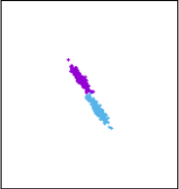
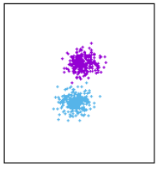
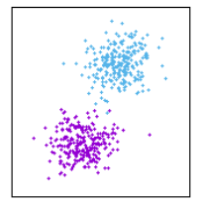
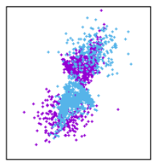
Challenges
Independent Rs to preclude collusion
No single linear transform to extract features
An example of 4-node system with 2D data
Original data
Projected data on each node
Projected data mixed
Significantly increased pattern complexity of the mixed projected data
Can deep learning address this?
Notes:
However, when we apply different projection matrices to prevent the collusion attack, no single linear transform exists to effectively extract the features. So this may introduce challenges to the unsupervised feature learning.
Now, I use an example to illustrate. We consider a 4-node system with 2D data in two classes represented by the two different colors. These figures show the data projected by each participant. We can see that, for each participant, we can easily find a hyperplane to separate the two classes. However, when all the projected data arrive at the coordinator, they will be mixed and it is difficult to find a simple hyperplane to separate the two classes. It is because it significantly increases pattern complexity of the mixed projected data
Now, our question is that whether deep learning can address this challenge. We answer this question by extensive evaluation.

Slide 16
Our approach
Gaussian random projection + deep learning
Gaussian random projection + SVM
Grid search for best setting of RBF kernel (several days)
Gaussian random projection + non-collaborative deep learning
Coordinator builds individual models for participants
Noise addition + deep learning
Noise addition ensures differential privacy
Noise addition + SVM
vs
Baseline approaches
Notes:
We compare our approach with a number of baseline approaches.
Our approach is Gaussian random projection plus deep learning.
The baseline approaches are combinations of different privacy protection methods and different learning approaches.
The first one is Guassian random projection plus SVM. We use Grid search for best setting of RBF kernel for SVM but it may cost several days.
The second one is Gaussian random projection plus non-collaborative deep learning, meaning that the coordinator will build individual models for the participants.
The next one is noise addition plus deep learning. The noise addition ensures different privacy.
The last one is noise addition plus SVM.

Slide 17
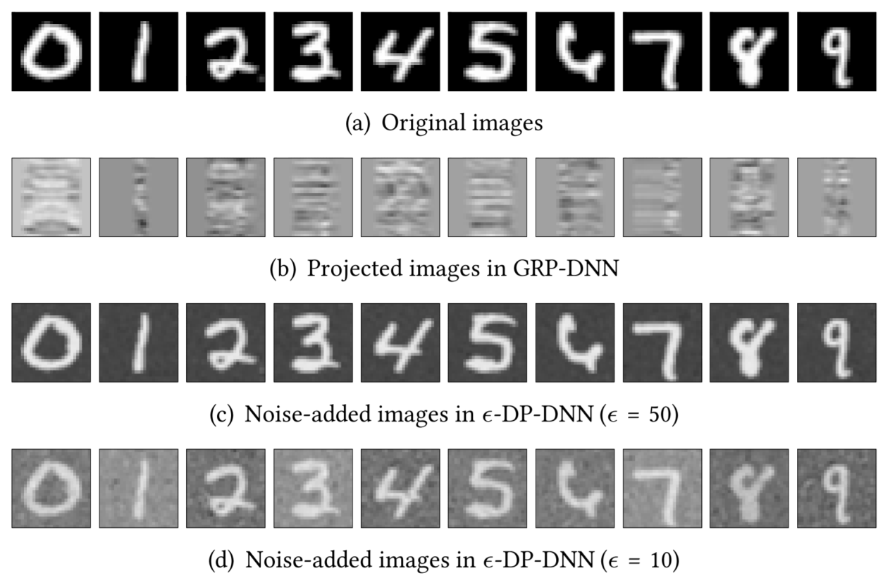
MNIST Dataset
Original samples
Gaussian random projection
Noise-added samples for differential privacy (ε = 50)
Noise-added samples for differential privacy (ε = 10)
Notes:
We evaluate the different approaches based on the MNIST dataset, which consists of handwritten digits, as illustrated by the first row of images.
The second row is the randomly projected images. We can see that it is difficult to recognize the digits from the projection.
The third and the last row show the noise-added samples for differential privacy with two different protection levels. We can see that we can still recognize the digits.

Slide 18


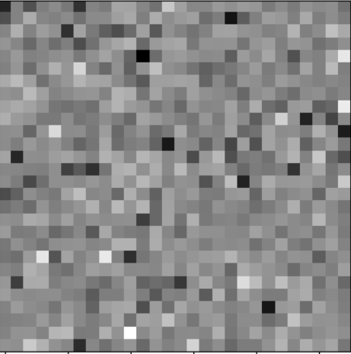
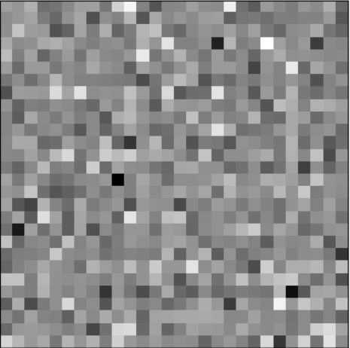
Differential Privacy
ε = 50
ε =0.001
Cannot be
distinguished
with full
confidence
Cannot be
distinguished
at all
differ on
one pixel
ε = 50
ε =0.001
Notes:
Now, I briefly explain the differential privacy.
Consider two samples that differ on only one pixel, to protect the differential privacy with a very small epsilon value, we need to add very large noises such that the result images cannot be distinguished.
If we want to protect the differential privacy with a larger epsilon value, we can reduce the intensity of the noises so that the result images cannot be distinguished with full confidence.
So, the epsilon represents the level of differential privacy loss.

Slide 19
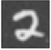


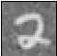
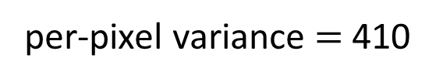
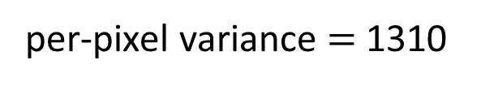
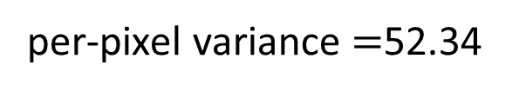
Noise Addition vs. Random Projection
Both protect confidentiality of raw forms of training data
Noise addition provides differential privacy
Use raw data reconstruction error as the common criterion
per-pixel variance $=$52.34
Aim to reconstruct
ϵ = 50
per-pixel variance $=$1310
per-pixel variance $=$410
ϵ = 10
Notes:
Both the noise addition approach and Gaussian random projection protect the confidentiality of the raw forms of the training. So, in this paper, we use the raw data reconstruction error as the common criterion, although we know that the noise addition provides extra privacy property, which is the differential privacy.
Under the noise addition approach to achieve an epsilon value of 50, we need a noise variance of about 52. To achieve an epsilon value of 10, we need a noise variance of more than 1000.
Under the Gaussian random projection approach, we assume that the coordinator knows the distribution of the random matrix. From our evaluation for the MNIST data, with the standard normal distribution, the average raw data reconstruction error is about 400.
To make two approached comparable, we choose proper epsilon value to achieve same raw data reconstruction error

Slide 20
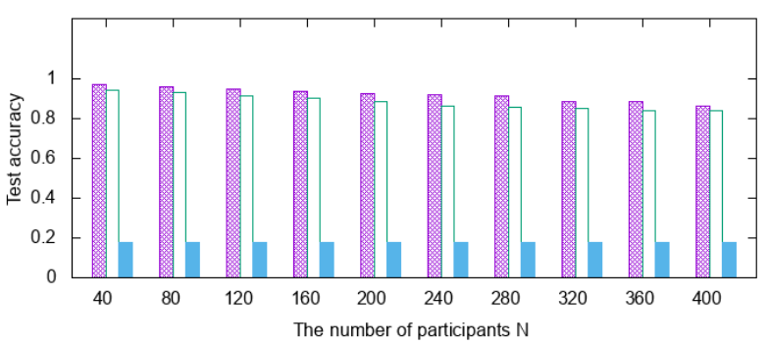
Results
CNN: 2 conv layers, 3 dense layers, max pooling
98.7% accuracy on original data
SVM (LIBSVM)
98.5% accuracy on original data
Impact of # of participants on learning performance
Our approach
Gaussian random projection + non-collaborative deep learning
Gaussian random projection + SVM
Notes:
We design a convolutional neural network with 2 convolutional layers, 3 dense layers, and max pooling. On the original data, this network can achieve 98.7% accuracy.
We also use the LIBSVM to implement the SVM baseline approach, which achieves 98.5% accuracy.
This figure shows the test accuracy of different approaches versus the number of participants that is up to 400.
When 40 participants are in the system, our approach can achieve 97% accuracy. When the number of participants increases to 400, our approach has an accuracy drop of 8%.
The non-collaborative learning approach achieves a slightly lower accuracy. However, it requires the participants to render their identity when submitting data, such that the coordinator can build the respective model for each participant. Differently, our approach doesn’t require this identity information.
We can also see that the SVM approach doesn’t work on the projected data in MNIST.

Slide 21
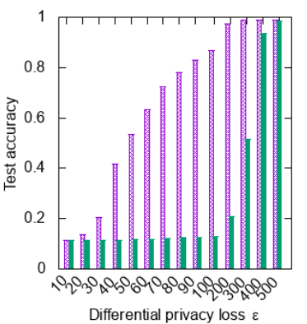
Results
Impact of ε on learning performance
Noise addition + deep learning
Noise addition + SVM
Notes:
This figure shows the results of the noise addition approach. The x-axis is the achieved epsilon value, the y-axis is the test accuracy. Under our approach, the attackers’ reconstruction error is about 400. To achieve the same level of reconstruction error, the epsilon value needs to be around 20. Under this epsilon value, the test accuracy achieved by the two noise addition approaches is just about 14%. This shows both SVM and deep learning cannot tolerate added noises well.

Slide 22
Overhead
Implementations on a testbed of 14 Raspberry Pis
Pi: support all baseline approaches
Our approach can be implemented on mote-class platforms
4x communication!
 | Overhead | Ours | Crowd-ML | CryptoNets
Training | Participant communication volume | 33.6 MB | 117.2 MB | n/a
 | Participant compute time | 0.96 s | 367.24 s | n/a
 | Coordinator compute time | 928.34 s | 1.04 s | n/a
Inference | Participant communication volume | 5.6 MB | n/a | 15.0 MB
 | Participant compute time | 0.16 s | 4.67 s | 116 hours
 | Coordinator compute time | 40.88 s | n/a
350x computation!
2.6m x
computation!
Crowd-ML: A Privacy-Preserving Learning Framework for a Crowd of Smart Devices, ICDCS’11
Cryptonets: Applying neural networks to encrypted data with high throughput and accuracy, ICML’16
Notes:
We also implement our approach on a testbed of 14 Raspberry Pis. We compare our approach with Crowd-ML and CryptoNets. The Crowd-ML is a distributed machine learning approach. The CrytoNets is an inference outsourcing approach.
The choice of the Raspberry Pi is because it can support all the baseline approaches. For example, the CryptoNets needs intensive computation. Note that our approach can be easily implemented on mote-class platforms.
The table shows the measured computation and communication overhead. We can see that the Crowd-ML incurs 4x of communication overhead and more than 300 times of computation overhead compared with our approach during the training phase.
During the interference phase, the CryptoNets incurs 2.6 million times computation overhead compared with our approach due to its homomorphic encryption.

Slide 23
Conclusion
Lightweight privacy-preserving collaborative learning
Participant: random Gaussian projection
Coordinator: deep learning
Better than
Non-collaborative scheme, SVM, noise addition
Suitable for IoT objects
Low complexities
Notes:
In summary, in this paper, we propose a Lightweight privacy-preserving collaborative learning approach. In this approach, each participant run random Gaussian projection to project data, and the cooridinator apply deep learning to learn a good model. From our evaluation we can see our approach is better than Non-collaborative scheme, SVM, noise addition approach. From our implementation it shows that our approach is suitable for IoT objects since it has low complexities.
In this work, we also have more evaluation results based on several other datasets. They can be found in the paper.
Thanks. Now I will take questions.

